Slide 1

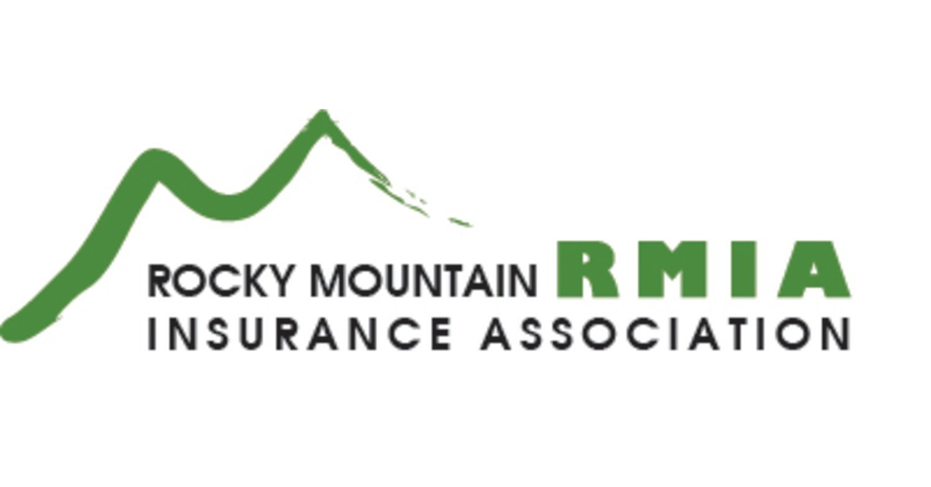
Hail Claims
Presented to:
MDD Forensic Accountants
Presenter: Conrad Biegel, CPA, CVA
Making Numbers Make Sense > mdd.com

Slide 2
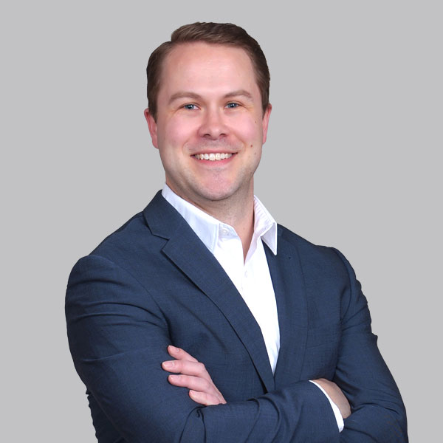





Conrad Biegel, CPA, CVA, MSA
Partner
English
cbiegel@mdd.com
+1 321.297.7657
Denver
  Experience
  Conrad’s practice focuses on accounting for financial and economic damages and opportunities in conjunction with litigation, business transactions, arbitration, appraisal, subrogation, and commercial, cyber and automobile insurance. He has been involved in numerous engagements related to litigation support and testimony, business valuations/mergers and acquisitions, business interruption, financial condition analyses and modeling, lost profits, extra expenses/increased costs, liability losses, fidelity claims/employee dishonesty, major construction costs or delays, tracing of funds and assets, business disputes, divorce and marital disputes and personal injury/wrongful death.
  Seminars
  Has conducted numerous seminars and workshops on many issues related to economic damage quantification.
Practice Areas
Industry Experience
  Business Interruption
  Business Disputes & Shareholder Disputes
  Cyber Risks
  Environmental Damages and Toxic Tort
  Fraud and Investigations
  Professional Liability
  Subrogation
  Agriculture
  Construction
  Healthcare
  Hospitality and Tourism
  Manufacturing
  Mining
  Transportation

Slide 3
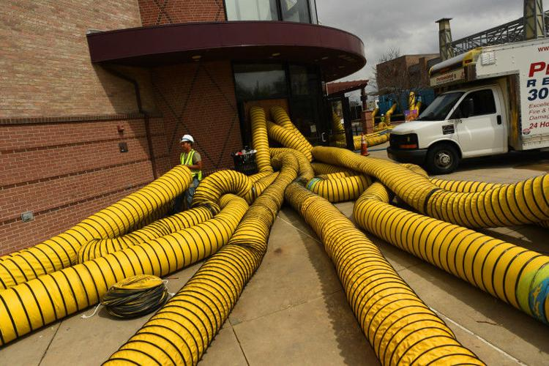
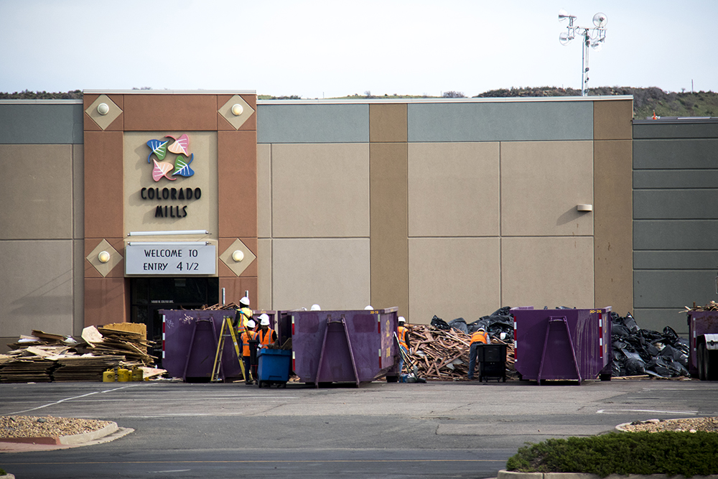

Colorado Hailstorms - Property
Sources: https://gazette.com/employees-at-hail-damaged-colorado-mills-restaurant-continued-getting-paid-during-closure/article_f58943f0-cc20-5596-abc8-3daa6b0dc5d2.html & https://denverite.com/2017/05/23/report-denver-area-may-8-hailstorm-pace-expensive-colorado-history/
Notes:
May 8, 2017? Large hail pummeled Denver's west side, from Arvada and Wheat Ridge to Lakewood. The hail caused an estimated 150,000 auto insurance claims and an additional 50,000 claims on homes and businesses. To date it is the most costly hailstorm in the metro area's entire weather history.

Slide 4
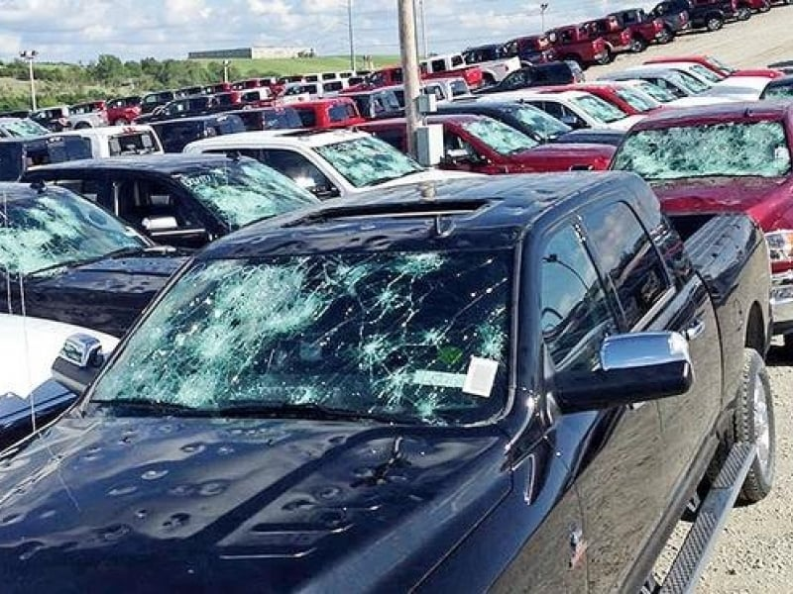
Colorado Hailstorms - Auto
Source: https://www.autonews.com/article/20140611/RETAIL/140619960/hail-on-wheels-no-problem-as-shoppers-clamor-for-deals-on-damaged-cars

Slide 5
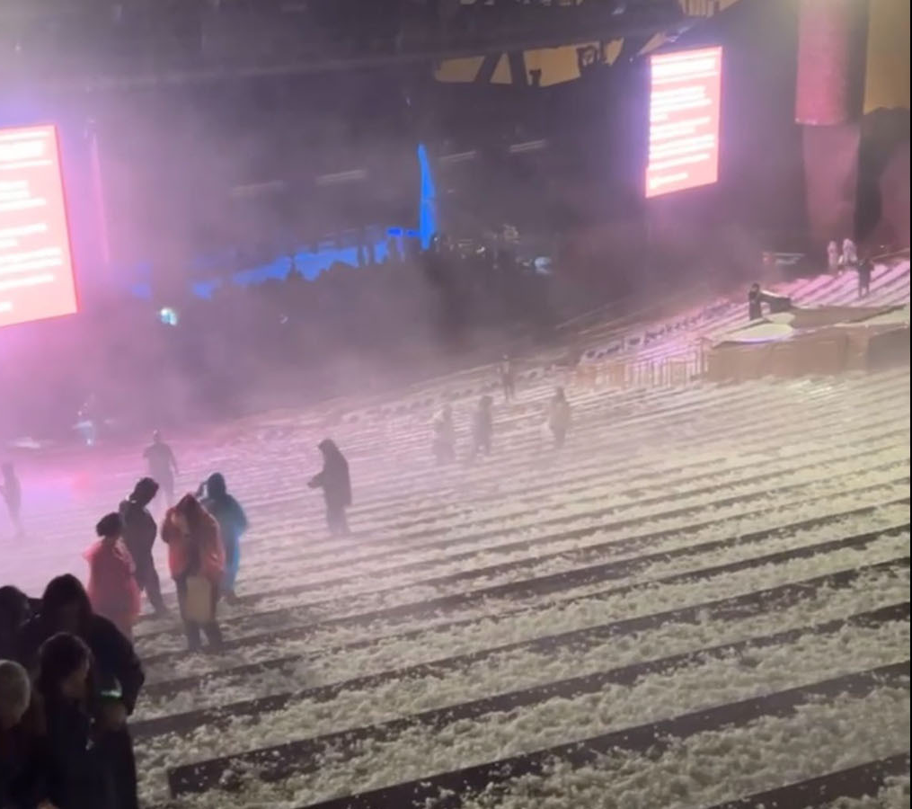
Colorado Hailstorms – Contingency & Other Claims
Source: https://www.stereogum.com/2227883/louis-tomlinson-hail-storm-red-rocks-concert/news/
Notes:
Louis Tomlinson

Slide 6

Colorado Hailstorms - Litigation
Source: https://www.alpharoofingtexas.com/faq/hail-damage-roof-system/

Slide 7
When PA’s Are Involved In Claims

Slide 8
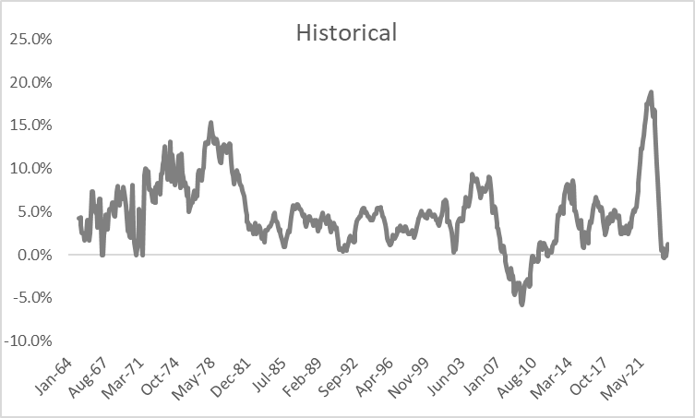
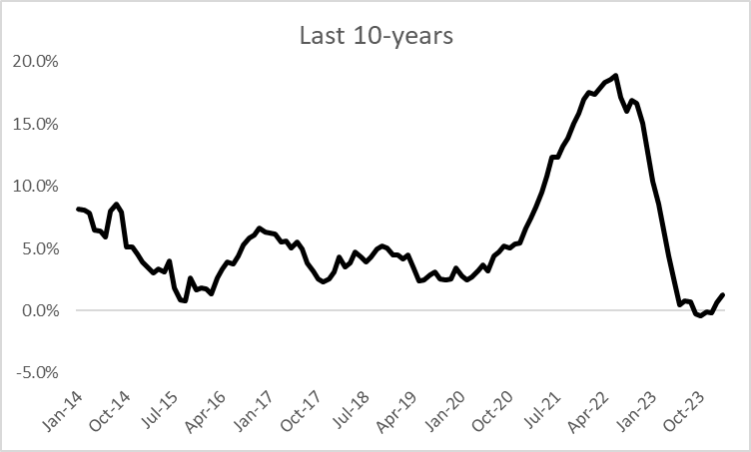
Fisher Price Index (%) - New Single-family Houses Under Construction

Slide 9

Property Damage Values
What can the insured’s balance sheet teach us?
  Inventory
  Property, Plant & Equipment
Shortcomings of balance sheet:
  Recorded at historical cost
  At depreciated amount
  Not RC or ACV
    Inventory may be close to both RC and ACV

Slide 10
Business Interruption Insurance
The objective of Business Interruption insurance is to put the company in the same financial position that it would have been, but for the loss incident (subject to self-insured elements).

Slide 11

Common Issues in Reporting Insurable Business Values
Data Selection Errors
  Use of prior year values despite steady growth
  Reporting Net Income instead of Gross Earnings
  Reporting less than annual values
  Reporting inventory values at lowest point of year
  Reporting net book value for assets
  Reporting assets at historical cost
  Ignoring interdependencies and contingencies
  Ignoring assets that have been fully depreciated
Calculation Errors
  Deducting Payroll Costs when Payroll is Insured
  Deducting theoretical saved expenses
  Deducting cost of goods sold instead of cost of materials in a manufacturing setting
B.I. value is not the same as the B.I. loss
Notes:
EXAMPLES FOR EACH ITEM

Slide 12
Selecting & Locating Information
IRS Industry Statistics
Hotel Stats – Smith Travel
Fuel Prices- U.S. Energy Information Administration
Key Value Data
National Trade and Professional Associations
Risk Management Assn. (RMA) Industry Statistic
Public Companies
Colorado Secretary of State
Colorado Department of Revenue
County/City Data
Other Sources:
    Federal Reserve Board
    FDIC
    Census Bureau
    Bureau of Labor Statistics
    Department of Labor
Averages
Economic Data

Slide 13

Proprietary and Confidential
  This presentation contains information that is confidential and proprietary to Matson, Driscoll & Damico, LLP and may contain trade secrets. It is intended to be strictly confidential and is to be used solely for discussion purposes. No part of this presentation may be disclosed to any third party or reproduced by any means without the prior written consent of Matson, Driscoll & Damico, LLP. This presentation does not constitute work product, opinion or a deliverable.
  This presentation contains information in summary form and is therefore intended for general guidance only. It is not intended to be a substitute for detailed research or the exercise of professional judgment. Matson, Driscoll & Damico does not accept any responsibility for loss occasioned to any person acting or refraining from action as a result of any material in this presentation.
  On any specific matter, reference should be made to the appropriate advisor.
  MDD International is a global network of independent and autonomous entities that share a commitment to delivering a quality service to clients around the world. MDD International Limited was acquired by Davies in 2024 which is ultimately controlled by Tennessee TopCo Limited, the overall controller of the Davies Group of companies.
  Matson, Driscoll & Damico LLP, including its subsidiaries and affiliates, is not a certified public accounting firm or a law firm and does not perform attest services, compilation services, public accounting services or any other service that a firm that uses the title “CPA” or “CPA firm” performs.
  © 2024 Matson, Driscoll & Damico, LLP.
  All rights reserved.

